Slide 1

Database Concepts & Technologies II
Lecture 2
K. O. Peasah
kopeasah.cos@knust.edu.gh // 024-426-3434

Slide 2


Slide 3
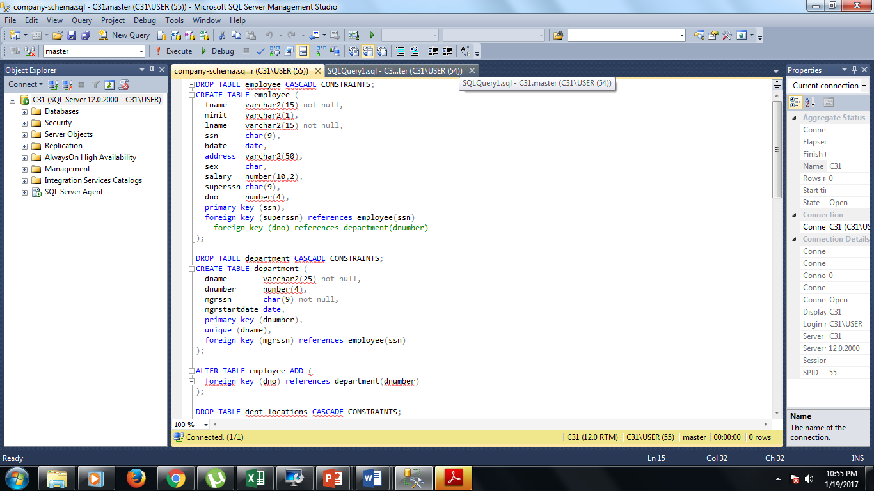

Slide 4
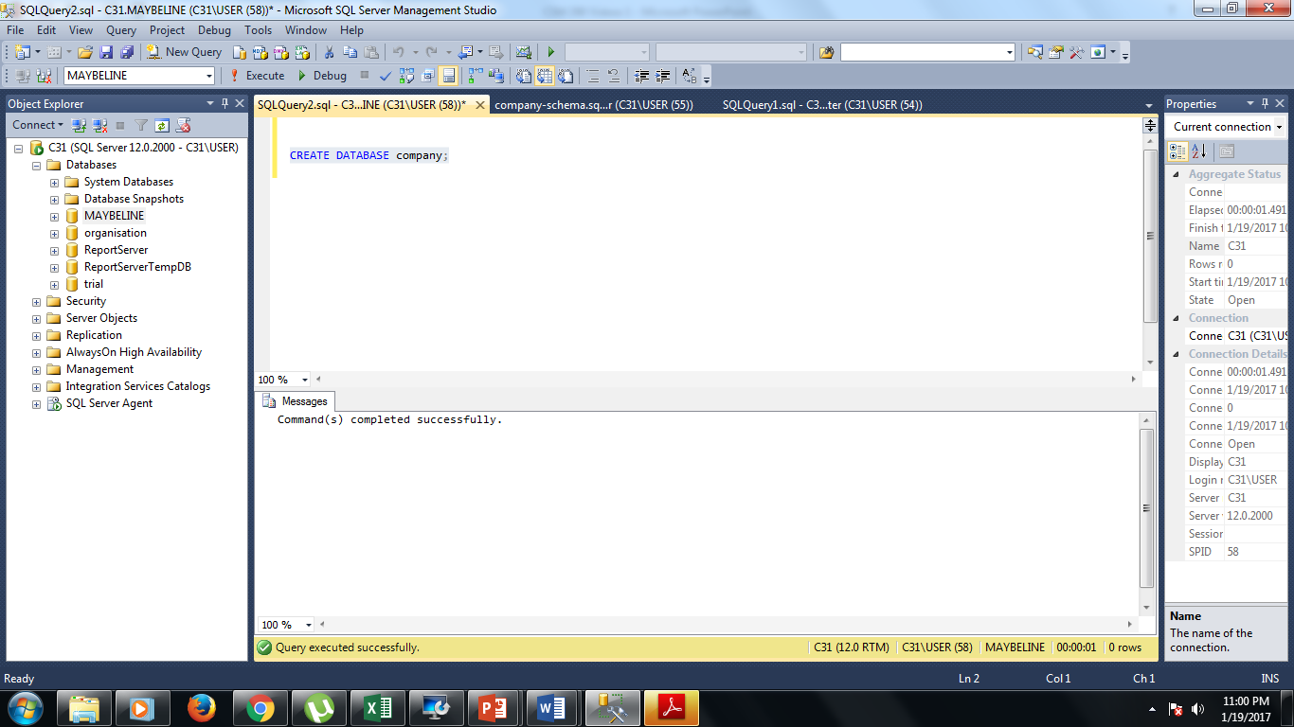

Slide 5
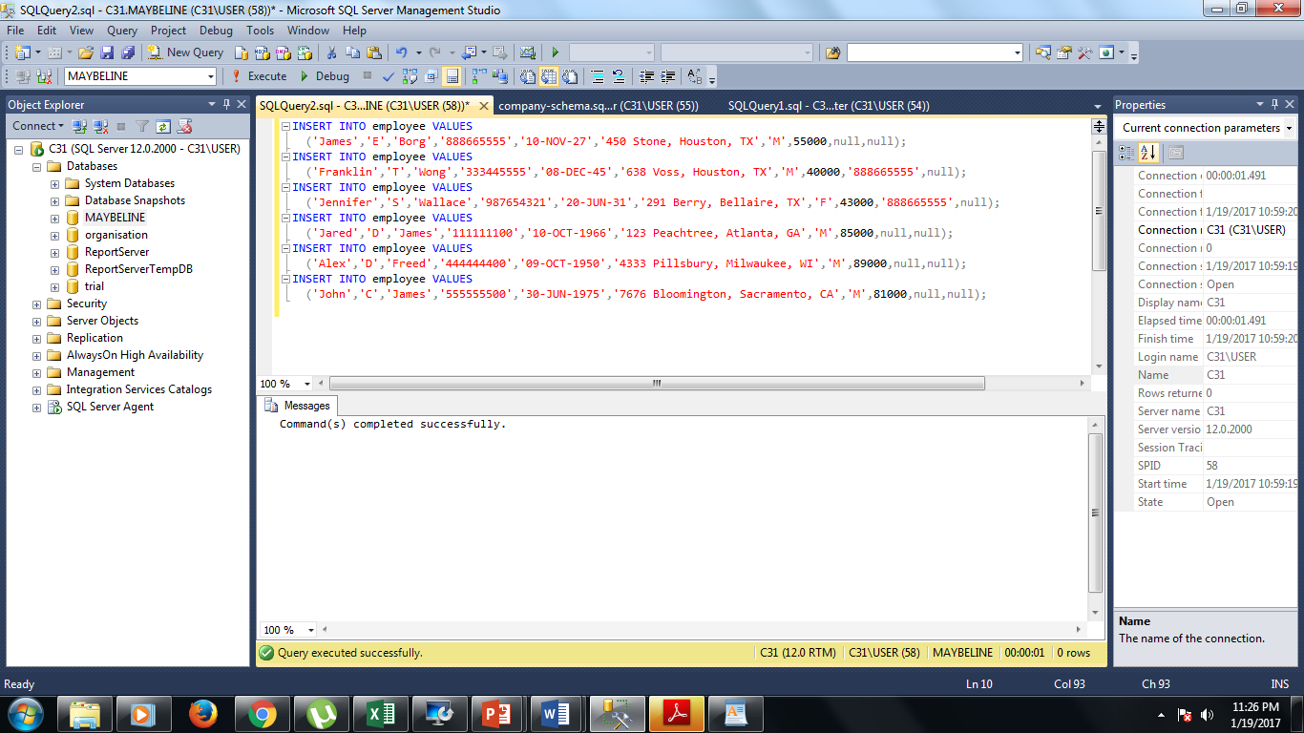

Slide 6
QUERY 1: Retrieve the birth date and address of the employee(s) whose name is ‘John B. Smith’.
SELECT Bdate, Address
FROM EMPLOYEE
WHERE Fname = ‘John’ AND Minit = ‘B’ AND Lname = ‘Smith’;

Slide 7
QUERY 2: Retrieve the name and address of all employees who work for the 'Research' department.
SELECT FNAME, LNAME, ADDRESS FROM EMPLOYEE, DEPARTMENT WHERE DNAME='Research' AND DNUMBER=DNO

Slide 8
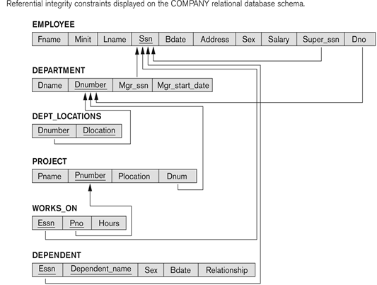

Slide 9
QUERY 3: For every project located in 'Stafford', list the project number, the controlling department number, and the department manager's last name, address, and birthdate.
SELECT PNUMBER, DNUM, LNAME,
BDATE, ADDRESS FROM PROJECT, DEPARTMENT, EMPLOYEE WHERE PLOCATION='Stafford‘ AND DNUM=DNUMBER AND MGRSSN=SSN

Slide 10
QUERY 4: The following statement retrieves the CustomerID, CompanyName, and ContactName data for companies who have a CustomerID value equal to alfki or anatr. The result is ordered according to the ContactName value:
USE Northwind
SELECT CustomerID, CompanyName, ContactName
FROM Customers
WHERE CustomerID = ‘alfki’ OR CustomerID =‘anatr’
ORDER BY ContactName

Slide 11
Ambiguous Attribute Names, Aliasing, and Tuple Variables
In SQL the same name can be used for two (or more) attributes as long as the attributes are in different relations.
If this is the case, and a query refers to two or more attributes with the same name, we must qualify the attribute name with the relation name to prevent ambiguity.
This is done by prefixing the relation name to the attribute name and separating the two by a period.

Slide 12
Example: Ambiguous Attribute Names
SELECT Fname, EMPLOYEE.Name, Address
FROM EMPLOYEE, DEPARTMENT
WHERE DEPARTMENT.NAME='Research' AND DEPARTMENT.Dnumber= EMPLOYEE. Dnumber ;

Slide 13
Ambiguous Attribute Names, Aliasing, and Tuple Variables
Ambiguity also arises in the case of queries that refer to the same relation twice, as in the following example.
QUERY 5: For each employee, retrieve the employee's name, and the name of his or her immediate supervisor. Q5:SELECT E.FNAME, E.LNAME, S.FNAME, S.LNAME FROM EMPLOYEE AS E, EMPLOYEE AS S WHERE E.SUPERSSN=S.SSN

Slide 14
Ambiguous Attribute Names, Aliasing, and Tuple Variables
In this case, we are allowed to declare alternative relation names E and S, called aliases or tuple variables, for the EMPLOYEE relation. An alias can follow the keyword AS, as shown in Q5,

Slide 15
Unspecified WHERE Clause and Use of the Asterisk
A missing WHERE clause indicates no condition on tuple selection; hence all tuples of the relation specified in the FROM clause qualify and are selected for the query result.
If more than one relation is specified in the FROM clause and there is no WHERE clause, then CROSS PRODUCT – all possible tuple combinations – of these relations is selected.

Slide 16
For example, Query 6 selects all EMPLOYEE Ssns and Query 7 selects all combinations of an EMPLOYEE Ssn and a DEPARTMENT Dname.
Q6: SELECT Ssn
FROM EMPLOYEE
Q7: SELECT Ssn, Dname
FROM EMPLOYEE, DEPARTMENT

Slide 17
Use of Asterisk
To retrieve all the attribute values of the selected tuples, we do not have to list the attribute names explicitly in SQL; we just specify an asterisk (*), which stands for all the attributes.
SELECT *
FROM EMPLOYEE
WHERE Dn = 5

Slide 18
Use of Asterisk
SELECT *
FROM EMPLOYEE, DEPARTMENT
WHERE Dname = ‘Research’ AND Dn = Dnumber
SELECT *
FROM EMPLOYEE, DEPARTMENT

Slide 19
Aggregate Functions in SQL
Grouping and aggregation are required in many database applications, SQL has features that incorporate these concepts.
A number of built-in functions exist: COUNT, SUM, MAX, MIN, and AVG.
The COUNT function returns the number of tuples or values as specified in a query.

Slide 20
Aggregate Functions in SQL
The functions SUM, MAX, MIN, and AVG are applied to a set of multiset of numeric values and return, respectively, the sum, maximum value, minimum value, and average (mean) of those values.
These functions can be used in the SELECT clause or in a HAVING clause (which we introduce later).

Slide 21
Aggregate Functions in SQL
The functions MAX and MIN can also be used with attributes that have nonnumeric domains if the domain values have a total ordering among one another.
We illustrate the use of these functions with example queries.

Slide 22
Find the sum of the salaries of all employees, the maximum salary, the minimum salary, and the average salary.
SELECT SUM(Salary), MAX(Salary), MIN(Salary),AVG(Salary)
FROM EMPLOYEE

Slide 23
Query 9: Find the sum of the salaries of all employees of the ‘Research’ department, as well as the maximum salary, the minimum salary, and the average salary in this department.
Q9: SELECT SUM(Salary), MAX(Salary), MIN(Salary),AVG(Salary)
FROM EMPLOYEE, DEPARTMENT
WHERE Dno=Dnumber AND Dname=‘Research’

Slide 24
Queries 10 and 11. Retrieve the total number of employees in the company (Q10) and the number of employees in the ‘Research’ department (Q11).
Q10: SELECT COUNT(*)
FROM EMPLOYEE
Q11: SELECT COUNT(*)
FROM EMPLOYEE, DEPARTMENT
WHERE Dno=Dnumber AND Dname=‘Research’

Slide 25
Grouping: The GROUP BY and HAVING Clauses
In many cases we want to apply the aggregate functions to subgroups of tuples in a relation, where the subgroups are based on some attribute values.
For example, we may want to find the average salary of employees in each department or the number of employees who work on each project.

Slide 26
Grouping: The GROUP BY and HAVING Clauses
In these cases we need to partition the relation into nonoverlapping subsets (or groups) of tuples.
Each group (partition) will consist of the tuples that have the same value of some attribute(s), called the grouping attribute(s).

Slide 27
Grouping: The GROUP BY and HAVING Clauses
We can then apply the function to each such group independently. SQL has a GROUP BY clause for this purpose.
The GROUP BY clause specifies the grouping attributes, which should also appear in the SELECT clause, so that the value resulting from applying each aggregate function to a group of tuples appears along with the value of the grouping attribute(s).

Slide 28
For each department, retrieve the department number, the number of employees in the department, and their average salary.
SELECT Dno,COUNT(*), AVG(Salary)
FROM EMPLOYEE
GROUP BY Dno

Slide 29
GROUP BY EXAMPLE
SELECT productid, count(*), sum(quantity)
FROM order_details
GROUP BY productid
The above will group by productid, count the orders per product and return the total quantity of each product that has been ordered from the Order Details table

Slide 30
GROUP BY EXAMPLE
For each project, retrieve the project number, the project name, and the number of employees who work on that project.
SELECT Pnumber, Pname, COUNT(*)
FROM PROJECT, WORKS_ON
WHERE Pnumber =Pno
GROUP BY Pnumber, Pname;

Slide 31
We will be back at exactly 9:30GMT

Slide 32
HAVING Clauses
When we want to retrieve the values of functions for only groups that satisfy certain conditions, then we use the HAVING Clause.
For example, suppose that we want to modify previous so that only projects with more than two employees appear in the result.
SQL provides a HAVING clause, which can appear in conjunction with a GROUP BY clause, for this purpose.

Slide 33
HAVING Clause
HAVING provides a condition on the group of tuples associated with each value of the grouping attributes. Only that satisfy the condition are retrieved in the result of the query.

Slide 34
HAVING Clause Example
Query: For each project on which more than two employees work, retrieve the project number, the project name, and the number of employees who work on the project.
SELECT Pnumber, Pname, COUNT(*)
FROM PROJECT, WORKS_ON
WHERE Pnumber =Pno
GROUP BY Pnumber, Pname
HAVING COUNT(*) > 2

Slide 35
The ORDER BY Clause
The ORDER BY clause sorts a query result by one or more columns (up to 8060 bytes).
A sort can be ascending (ASC) or descending (DESC). If neither is specified, ASC is assumed. If more than one column is named in the ORDER BY clause, sorts are nested.

Slide 36
The ORDER BY Clause - Example
USE Pubs
SELECT Pub_id, Type, Title_id, Price
FROM Titles
ORDER BY Pub_id DESC, Type, Price

Slide 37
INSERT, DELETE and UPDATE Statements in SQL
In its simplest form, INSERT is used to add a single tuple to a relation.
We must specify the relation name and a list of values for the tuple.
The values should be listed in the same order in which the corresponding attributes were specified in the CREATE TABLE command.

Slide 38
INSERT -Example
For example, to add a new tuple to the EMPLOYEE relation ; we can use
INSERT INTO EMPLOYEE VALUES ('Richard','K','Marini', '653298653', '30-DEC-52','98 Oak Forest,Katy,TX', 'M',
37000,'987654321', 4 )

Slide 39
INSERT – Example 2
USE Northwind
INSERT INTO Territories
VALUES (98101, ‘Seatle’, 2)

Slide 40
INSERT –Type 2
A second form of INSERT statement allows the user to specify explicit attribute names that correspond to the values provided in the INSERT command.
This is useful if a relation has many attributes but only a few of those attributes are assigned values in the new tuple.

Slide 41
INSERT
The values must include all attributes with NOT NULL specification and no default value.
Attributes with NULL allowed or DEFAULT values are the ones that can be left out.

Slide 42
INSERT –Type 2 Example
For example, to enter a tuple for a new EMPLOYEE for whom we know only the Fname, Lname, Dno, and Ssn attributes, we can use the statement below:
INSERT INTO EMPLOYEE (FNAME, LNAME, Dno, SSN) VALUES ('Richard', 'Marini',4, '653298653')

Slide 43
UPDATE
The UPDATE command is used to modify attribute values of one or more selected tuples.
As in the DELETE command, a WHERE clause in the UPDATE command selects the tuples to be modified from a single relation.

Slide 44
UPDATE
However, updating a primary key value may propagate to the foreign key values of tuples in other relations if such a referential triggered action is specified in the referential integrity constraints of the DDL.
An additional SET clause in the UPDATE command specifies the attributes to be modified and their new values.

Slide 45
UPDATE - Example
For example, to change the location and controlling department number of project number 10 to ‘Bellaire’
and 5 respectively, we use the statement below:
UPDATE PROJECT SET PLOCATION = 'Bellaire', DNUM = 5 WHERE PNUMBER=10

Slide 46
DELETE STATEMENT
The DELETE statement removes rows from a table
DELETE
FROM [table]
WHERE {condition}

Slide 47
DELETE STATEMENT - Example
This example deletes all rows from the authors table.
USE pubs
DELETE authors

Slide 48
DELETE STATEMENT - Example
This example deletes all rows in which au_lname is McBadden.
USE pubs
DELETE FROM authors
WHERE au_lname = 'McBadden'

Slide 49
End

Slide 50
Thank You
For any concerns, please contact
elearning@knust.edu.gh
elearningknust@gmail.com
0322 191132

Slide 51
VIEWS
A view in SQL/MySQL terminology is a single table that is derived from other tables.
These other tables can be base tables or previously defined views.
A view does not necessarily exist in physical form; it is considered a virtual table, in contrast to base tables, whose tuples are actually stored in the database.

Slide 52
VIEWS
In SQL, a view is a virtual table based on the result-set of an SQL statement.
A view contains rows and columns, just like a real table.
The fields in a view are fields from one or more real tables in the database.
View doesn't actually store information itself, but just pulls it out of one or more existing tables.
Although impermanent, a view may be accessed repeatedly by storing its criteria in a query.

Slide 53
VIEWS
We may frequently issue queries that retrieve the employee name and the project names that the employee works on.
Rather than having to specify the join of the EMPLOYEE, WORKS_ON, and PROJECT tables every time we issue that query, we can define a view that is a result of these joins.

Slide 54
VIEWS
Then we can issue queries on the view, which are specified as single table retrievals rather than as retrievals involving two joins on three tables.
We call the EMPLOYEE, WORKS_ON, and PROJECT tables the defining tables of the view.

Slide 55
SYNTAX
CREATE
[OR REPLACE]
[ALGORITHM = {UNDEFINED | MERGE | TEMPTABLE}]
[DEFINER = { user | CURRENT_USER }]
[SQL SECURITY { DEFINER | INVOKER }]
VIEW view_name [(column_list)]
AS select_statement
[WITH [CASCADED | LOCAL] CHECK OPTION]
If the view does not exist, CREATE OR REPLACE VIEW is the same asCREATE VIEW
If the view does exist, CREATE OR REPLACE VIEW is the same as ALTER VIEW.

Slide 56
The view definition is “frozen” at creation time, so changes to the underlying tables afterward do not affect the view definition.
For example,
if a view is defined as SELECT * on a table, new columns added to the table later do not become part of the view

Slide 57
VIEW – Example
CREATE VIEW WORKS_ON1
AS SELECT Fname, Lname, Pname, Hours
FROM EMPLOYEE, PROJECT, WORKS_ON
WHERE Ssn=Essn AND Pno =Pnumber
CREATE VIEW DEPT_INFO(Dept_name, No_of_emps, Total_sal)
AS SELECT Dname, COUNT (*), SUM(Salary)
FROM DEPARTMENT, EMPLOYEE
WHERE Dnumber=Dno
GROUP BY Dnumber

Slide 58
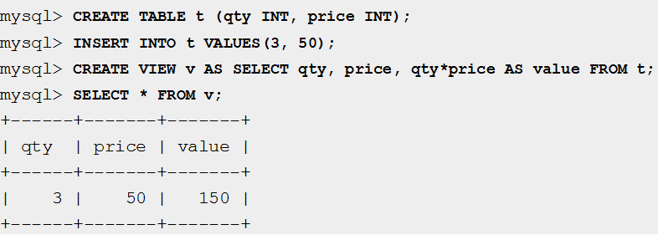
VIEW – Example

Slide 59
Querying A View
we can utilise the WORKS_ON1 view and specify the query as below:
SELECT Fname, Lname
FROM WORKS_ON1
WHERE Pname = ‘ProjectX’

Slide 60
Using Advanced Query Techniques To Access Data
One of these techniques is to combine the contents of two or more tables to produce a result set that incorporates rows and columns from each table.
Another technique is to use subqueries, which are SELECT statements nested inside other SELECT, INSERT, UPDATE, or DELETE statements.
Subqueries can also be nested in other subqueries.

Slide 61
Using Joins To Retrieve Data
By using joins, you can retrieve data from two or more tables based on logical relationships between the tables. Joins can be specified in either the FROM or WHERE clauses.
The join conditions combine with the WHERE and HAVING search conditions to control the rows that are selected from the base tables referenced in the FROM clause.
Specifying the join conditions in the FROM clause, however, helps separate them from any other search conditions that might be specified in a WHERE clause and is the recommended method for specifying joins.

Slide 62
JOINS
When multiple tables are referenced in a single query, all column references must be unambiguous.
The table name must be used to qualify any column name that is duplicated in two or more tables referenced in a single query.

Slide 63
JOINS
The select list for a join can reference all of the columns in the joined tables or any subset of the columns.
The select list is not required to contain columns from every table in the join.

Slide 64
JOINS
For example, in a three-table join, only one table can be used as a bridge from one of the other tables to the third table, and none of the columns from the middle table have to be referenced in the select list.
Although join conditions usually use the equals sign ( = ) comparison operator, other comparison or relational operators can be specified ( as can other predicates). Most joins can be categorized as inner joins or other joins.

Slide 65
JOINS
Inner joins return rows only when there is at least one row from both tables that matches the join condition, eliminating the rows that do not match with a row from the other table.
Outer joins, however, return all rows from at least one of the tables or views mentioned in the FROM clause as long as these rows meet any WHERE or HAVING search conditions.

Slide 66
INNER JOIN
An inner join is a join in which the values in the
columns being joined are compared through the use of
a comparison operator.
The following SELECT statement uses an inner join to retrieve data from the Publishers table and the Titles table in the Pubs database:
SELECT t.Title, p.Pub_name
FROM Publishers AS p INNER JOIN Titles AS t
ON p.Pub_id = t.Pub_id
ORDER BY Title ASC

Slide 67
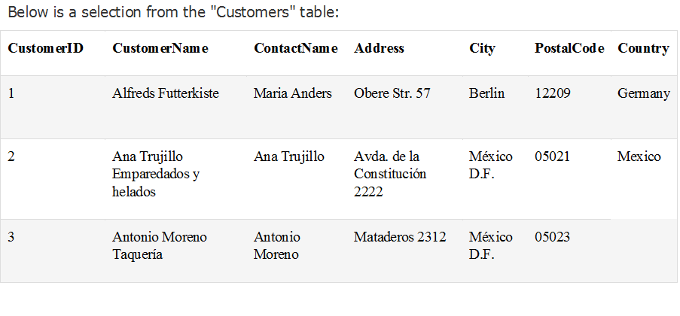

Slide 68
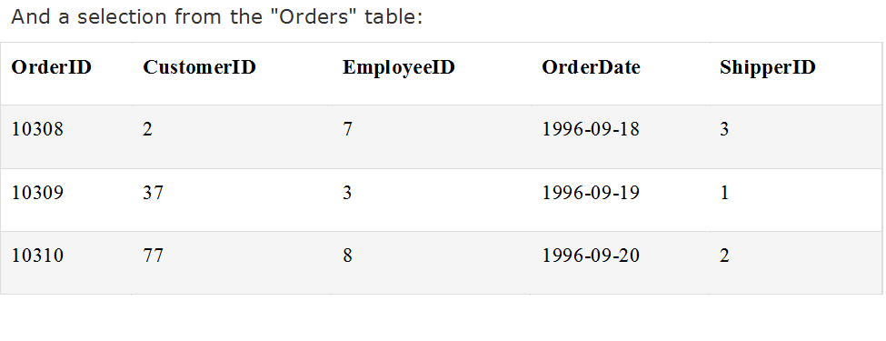

Slide 69
SELECT Customers.CustomerName, Orders.OrderID
FROM Customers
INNER JOIN Orders
ON Customers.CustomerID=Orders.CustomerID
ORDER BY Customers.CustomerName;

Slide 70
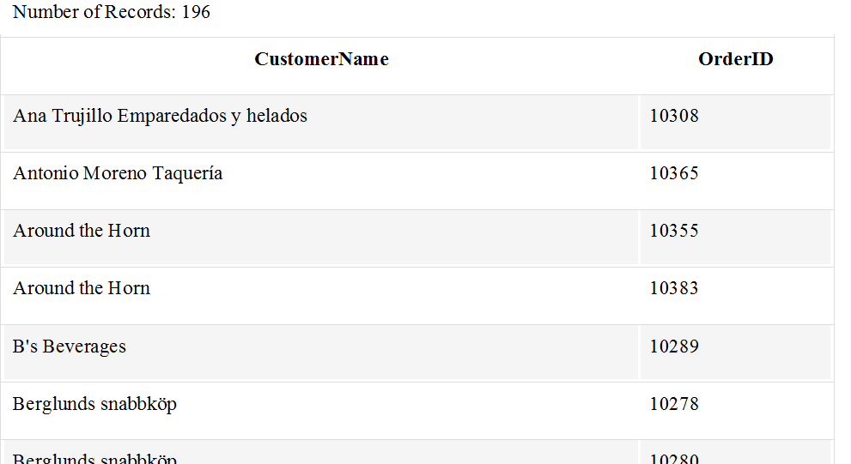

Slide 71
Outer Joins
There are three types of outer joins: left, right, and full.
All rows retrieved from the left table are referenced with a left outer join, and all rows from the right table are referenced in a right outer join.
All rows from both tables are returned in a full outer join.

Slide 72
Using Left Outer Joins
A result set generated by a SELECT statement that includes a left outer join includes all rows from the table referenced to the left of LEFT OUTER JOIN.
The only rows that are retrieved from the table to the right are those that meet join condition.

Slide 73
Using Left Outer Joins
In the following SELECT statement, a left outer join is used to retrieve the authors’ first names, and (when applicable) the names of any publishers that are located in the same cities as the authors:

Slide 74
Using Left Outer Joins
USE Pubs
SELECT a.Au_fname, a.Au_lname, p.Pub_name
FROM Authors a LEFT OUTER JOINPublishers p
ON a.City = p.City
ORDER BY p.Pub_name ASC, a.Au_lname ASC,
a.Au_fname ASC

Slide 75
Using Left Outer Joins
SELECT Customers.CustomerName, Orders.OrderID
FROM Customers LEFT JOIN Orders
ON Customers.CustomerID=Orders.CustomerID
ORDER BY Customers.CustomerName;

Slide 76
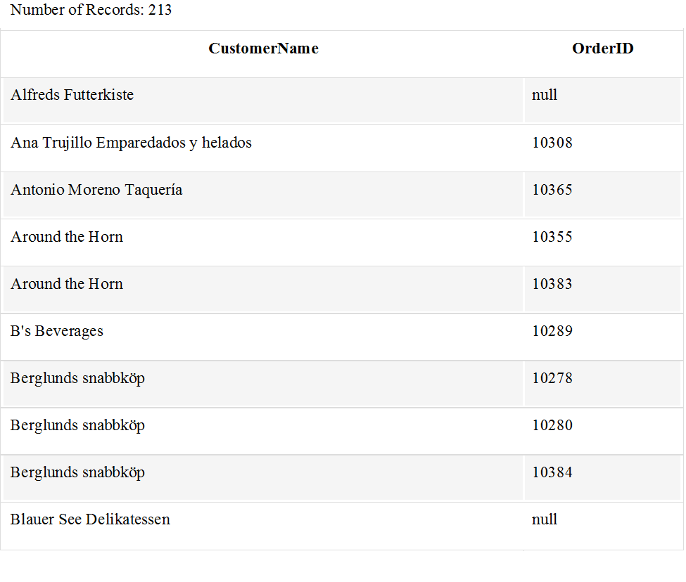

Slide 77
Using Right Outer Joins
A result set generated by a SELECT statement that includes a right outer join includes all rows from the table referenced to the right of RIGHT OUTER JOIN.
The only rows that are retrieved from the table to the left are those that meet the join condition.
In the following SELECT statement, a right outer join is used to retrieve the list of publishers and authors’ first names, and last names, if those authors are located in the same cities as the publishers:

Slide 78
Using Right Outer Joins
USE Pubs
SELECT a.Au_fname, a.Au_lname, p.Pub_name
FROM Authors a RIGHT OUTER JOIN Publishers p
ON a.City = p.City
ORDER BY p.Pub_name ASC, a.Au_lname ASC, a.Au_fname ASC

Slide 79
Using Full Outer Joins
A result set generated by a SELECT statement that includes a full outer join includes all rows from both tables, regardless of whether the tables have a matching value (as defined in the join condition).
In the following SELECT statement, a full outer join is used to retrieve the list of publishers and authors’ first and last names:

Slide 80
Using Full Outer Joins
USE Pubs
SELECT a.Au_fname, a.Au_lname, p.Pub_name
FROM Authors a FULL OUTER JOIN Publishers p
ON a.City = p.City
ORDER BY p.Pub_name ASC, a.Au_lname ASC,
a.Au_fname ASC

Slide 81
Using Full Outer Joins
SELECT Customers.CustomerName, Orders.OrderID
FROM Customers FULL OUTER JOIN Orders
ON Customers.CustomerID=Orders.CustomerID
ORDER BY Customers.CustomerName;

Slide 83
Defining Subqueries inside SELECT Statement
A subquery is a SELECT statement that returns a
single value and is nested inside a SELECT, INSERT,
UPDATE or DELETE statement or inside another
subquery.
A subquery can be used anywhere an expression is
allowed. A subquery is also called an inner query or
inner select, while the statement containing a
subquery is called an outer select.
In the following example, a subquery is nested in the
WHERE clause of the outer SELECT statement:

Slide 84
Subqueries
Subqueries are an alternate way of returning data from multiple tables.
Subqueries can be used with the following SQL statements along with the comparision operators like =, <, >, >=, <= etc.

Slide 85
Subquery - Example
USE Northwind
SELECT ProductName
FROM Products
WHERE UnitPrice =
{
SELECT UnitPrice
FROM Products
WHERE ProductName = ‘Sir Rodney’ ‘s
Scones’
}

Slide 86
Subqueries
If a table only appears in a subquery and not in the outer query, then columns from that table cannot be included in the output (the select list of the outer query).
Types of Subqueries
Subqueries can be specified in many places within a SELECT statement. Statements that include a subquery usually take one of the following formats:
WHERE <expression> [NOT] IN (<subquery>)
WHERE <expression> <comparison_operator> [ANY | ALL] (<subquery>)
WHERE [NOT] EXISTS (<subquery>)

Slide 87
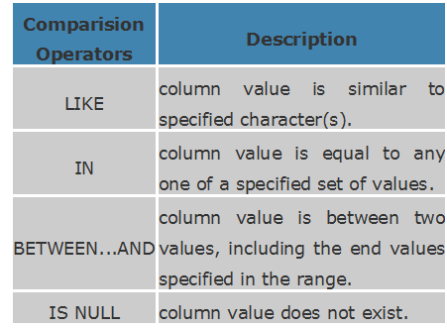

Slide 88
Subqueries that Are used with IN or NOT IN
The result of a subquery introduced with IN (or with NOT IN) is a list of zero or more values.
ie. Usually, a subquery should return only one record, but sometimes it can also return multiple records when used with operators LIKE, IN, NOT IN in the where clause. The query syntax would be like,
After the subquery returns the result, the outer query makes use of it.
In the following example, a subquery is nested inside the WHERE clause, and the IN keyword is used:

Slide 89
SQL LIKE Operator
The LIKE operator is used to list all rows in a table whose column values match a specified pattern.
It is useful when you want to search rows to match a specific pattern, or when you do not know the entire value.
For this purpose we use a wildcard character '%'.

Slide 90
For example:
To select all the students whose name begins with 'S‘
SELECT first_name, last_name
FROM student_details
WHERE first_name LIKE 'S%';
The output would be similar to:
first_name last_name
------------- -------------
Stephen Fleming
Shekar Gowda

Slide 91
SQL LIKE Operator
The above select statement searches for all the rows where the first letter of the column first_name is 'S' and rest of the letters in the name can be any character.
There is another wildcard character you can use with LIKE operator. It is the underscore character, ' _ ' . In a search string, the underscore signifies a single character.

Slide 92
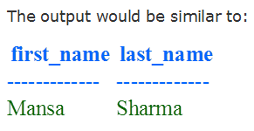
Example
To display all the names with 'a' second character
SELECT first_name, last_name FROM student_details WHERE first_name LIKE '_a%';

Slide 93
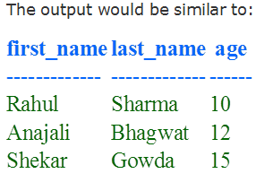
SQL BETWEEN ... AND Operator
The operator BETWEEN and AND, are used to compare data for a range of values.
For Example: to find the names of the students between age 10 to 15 years, the query would be like,
SELECT first_name, last_name, age FROM student_details WHERE age BETWEEN 10 AND 15;

Slide 94
SQL IN Operator:
The IN operator is used when you want to compare a column with more than one value. It is similar to an OR condition.
For example: If you want to find the names of students who are studying either Maths or Science, the query would be like,
SELECT first_name, last_name, subject
FROM student_details
WHERE subject IN ('Maths', 'Science');

Slide 95
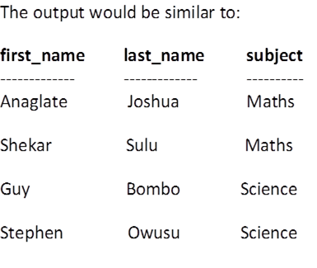
You can include more subjects in the list like ('maths','science','history')
NOTE:The data used to compare is case sensitive.

Slide 96
SQL IS NULL Operator
A column value is NULL if it does not exist. The IS NULL operator is used to display all the rows for columns that do not have a value.
For Example: If you want to find the names of students who do not participate in any games, the query would be as given below
SELECT first_name, last_name
FROM student_details
WHERE games IS NULL

Slide 97
Subquery - Example
USE Pubs
SELECT Pub_name
FROM Publishers
WHERE Pub_id IN
(
SELECT Pub_id
FROM Titles
WHERE Type = ‘business’
)

Slide 98
Subqueries that Are Used with Comparison Operators
Comparison operators that introduce a subquery can be modified with the keyword ALL or ANY.
Subqueries introduced with a modified comparison operator return a list of zero or more values and can include a GROUP BY or HAVING clause.
These subqueries can be restated with EXISTS.

Slide 99
Subqueries that Are Used with Comparison Operators
The ALL and ANY keywords each compare a scalar value with a single-column set of values.
The ALL keyword applies to every value, and the ANY keyword applies to at least one value.
In the following example, the greater than (>) comparison operator is used with the ANY keyword:

Slide 100
Subquery - Example
USE Pubs
SELECT Title
FROM Titles
WHERE Advance > ANY
(
SELECT Advance
FROM Publishers INNER JOIN Titles
ON Titles.Pub_id = Publishers.Pub_id
AND Pub_name = ‘Algodata Infosystems’
)

Slide 101
Subqueries that Are Used with EXISTS and NOT EXISTS
When a subquery is introduced with the keyword EXISTS, it functions as an existence test.
The WHERE clause of the outer query tests for the existence of rows returned by the subquery.
The subquery does not actually produce any data; instead, it returns a value of TRUE or FALSE.
In the following example, the WHERE clause in the outer SELECT statement contains the subquery and uses the EXISTS keyword.

Slide 102
Subquery - Example
USE Pubs
SELECT Pub_name
FROM Publishers
WHERE EXISTS
(
SELECT * FROM Titles
WHERE Titles.Pub_id = Publishers.Pub_id
AND Type = ‘Business’
)

Slide 103
End

Slide 104

Thank You
For any concerns, please contact
elearning@knust.edu.gh
elearningknust@gmail.com
0322 191132

